Slide 1
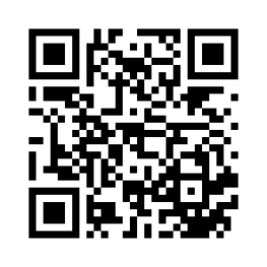
Let’s RETHINK Early Labour
Are you expecting your first baby, planning to experience early labour at home, and under midwifery care?
Will you take part in research exploring support for women in early labour?
Complete one online questionnaire when you are between 25 and 33 weeks and 6 days pregnant and a second online questionnaire about 3 weeks after you have had your baby.
We would also like to collect some details about your labour and birth.
For more information please ask your midwife or contact:
Chief Investigator: Vanessa Bartholomew
At: vbartholomew@bournemouth.ac.uk
To participate please scan the QR Code or go to:
https://bournemouth.onlinesurveys.ac.uk/rethink-study-270583
The RETHINK Study Version 1.11 08/05/2021 IRAS: 270583

