Slide 1

Peri-implantation Immune Profiling
In collaboration with Wolfson Fertility Centre
https://imperialprivatehealthcare.co.uk/fertility/
We aim to describe blood and endometrial immune cells women who are subfertile, have recurrent pregnancy loss or recurrent implantation failure and compare to women without fertility issues.
For further information please email
EarlyPregnancyResearch@wrh.ox.ac.uk

Slide 2
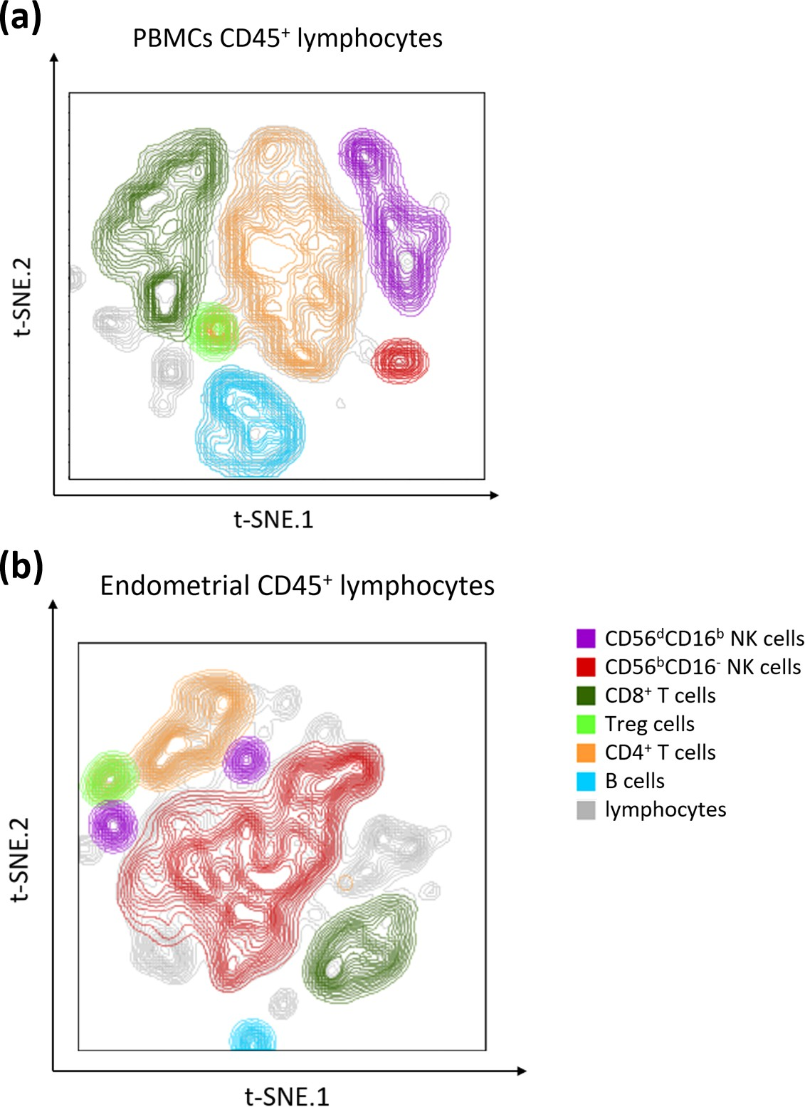
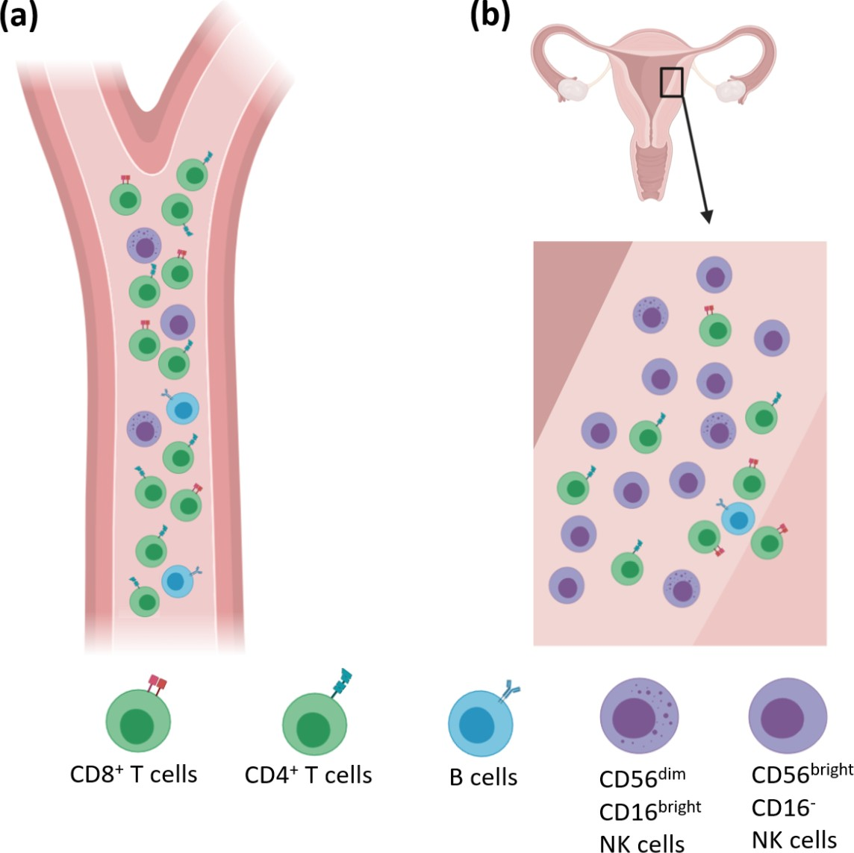
Flow cytometry reveals the immune cells present in each sample
The PIP study compares immune cells populations in the peripheral blood and endometrium from women – a venous blood sample and endometrial biopsy are taken in the mid-luteal phase of the menstrual cycle, prior to an IVF cycle or normal menstrual cycle.

